Slide 1
Invertible
Notes:
If AB = $I_{n}$ or BA = $I_{n}$ then A is invertible with inverse B and B is invertible with inverse A.
Listed another theorem

Slide 2

Unique Inverse
Notes:
Invertible matrices only have one inverse.

Slide 3
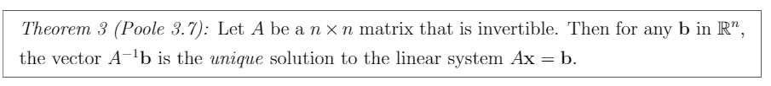
Invertible Unique Solution
Notes:
$A^{−1}b$ = x in Ax = b

Slide 4
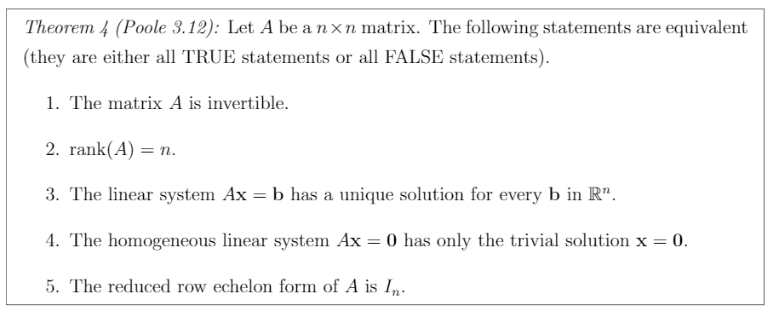
Fundamental Theorem of Invertible Matrices
Notes:
A is invertible
rank(A) = n
Ax=b has no free variables and zero rows (excluding b).
Homogenous linear system Ax = 0 has only trivial solution x = 0.
A reduces to $I_{n}$

Slide 5
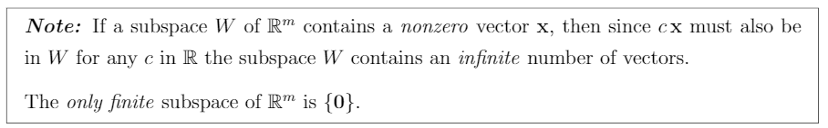
Finite, infinite subspaces
Notes:
Subspace contain every linear combination of nonzero vectors contained in it.
Only subspace {0} is finite.

Slide 6

Subspace
Notes:
The linear combination of the vectors in $R^{m}$ named W is a subspace of $R^{m}$.

Slide 7
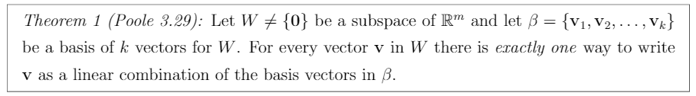
Basis
Notes:
Basis is the set of linearly independent vectors that represent subspace W which is not an empty set. (refer to slide 5)

Slide 8
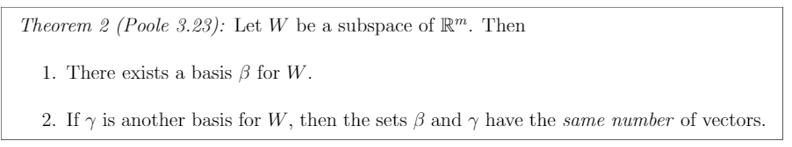
Subspace’s basis
Notes:
Any subspace W has:
A basis β for W
If another basis γ exist, β and γ have same number of vectors.

Slide 9
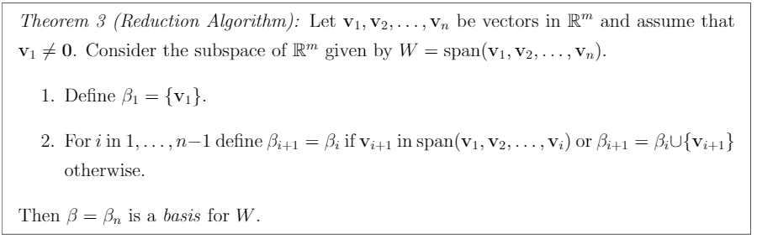
Reduction Algorithm
Notes:
Basically, how find the basis from a set of vectors. Look at the notes if you forgot how to find basis.

Slide 10
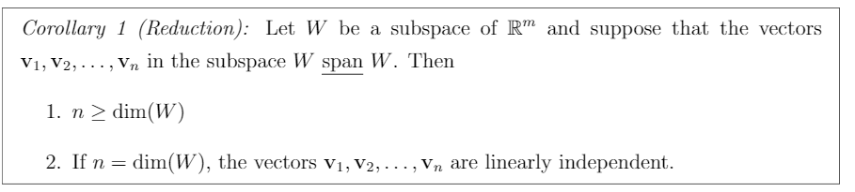
Reduction Corollary
Notes:
If the vectors $v_{1}$,…,$v_{n}$ in subspace W span W then:
n ≥ dim(W) (in order to span R2 for instance, we need at least 2 vectors).
If n = dim(W), $v_{1}$,…,$v_{n}$ are linear independent. (If we have 2 vectors in R2 that span R2, they must be pointing in different directions).
Note that n is the number of vectors in $v_{1}$,…,$v_{n}$.

Slide 11
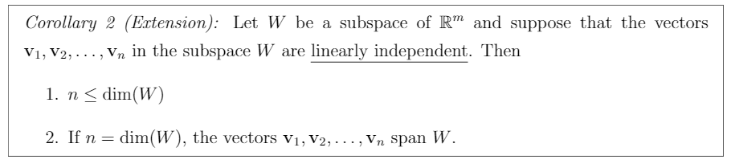
Extension Corollary
Notes:
If the vectors $v_{1}$,…,$v_{n}$ in subspace W are linearly independent then:
n ≤ dim(W) (Linear independent vectors cannot be reduced, therefore, the upper limit of n is the number of vectors in W).
If n = dim(W), $v_{1}$,…,$v_{n}$ span W. (If W consists of only linearly independent vectors, then those vectors generate all of W).

Slide 12
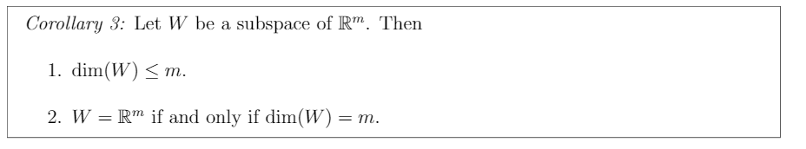
Subspace Properties
Notes:
If W is a subspace of $R^{m}$ then:
1. dim(W) ≤ m (If you have 3 linearly independent vectors, there exists 3 components in W (xyz) so W cannot exist in R2).
2. W = $R^{m}$ if and only if dim(W) = m (If you have 2 linearly independent vectors, they span R2, no exceptions)

Slide 13
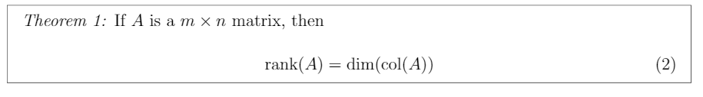
Rank & Column Dimension

Slide 14
Null and Subspace

Slide 15
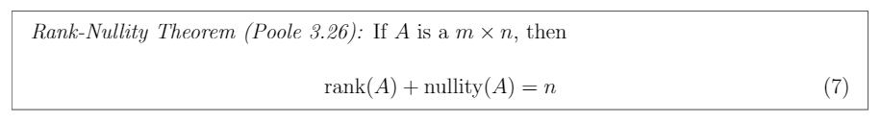
Rank Nullity Theorem

Slide 16
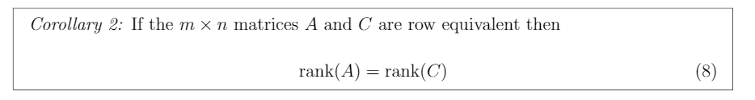
Row Equivalent Rank

Slide 17
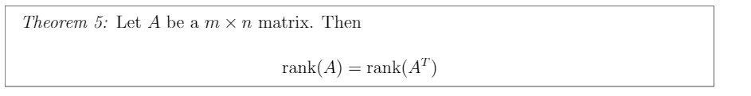
Rank vs Rank Transpose

Slide 18
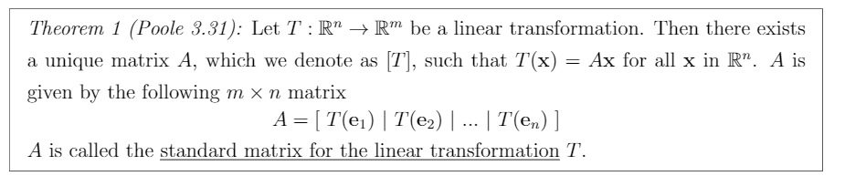
Standard Matrix

Slide 19
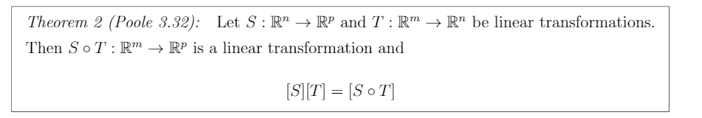
Standard Matrix Multiplication????

Slide 20
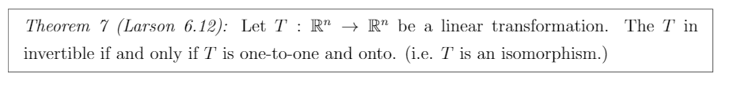
Isomorphism

Slide 21
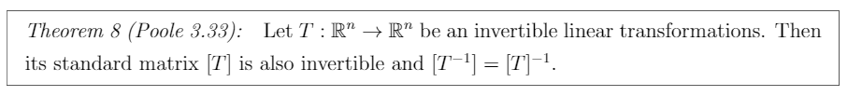
Invertible Linear Transformation and Standard Matrix

Slide 22
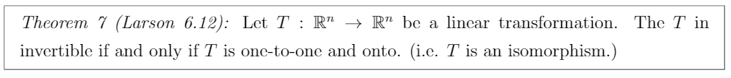
Invertible Linear Transformation and Standard Matrix

Slide 23
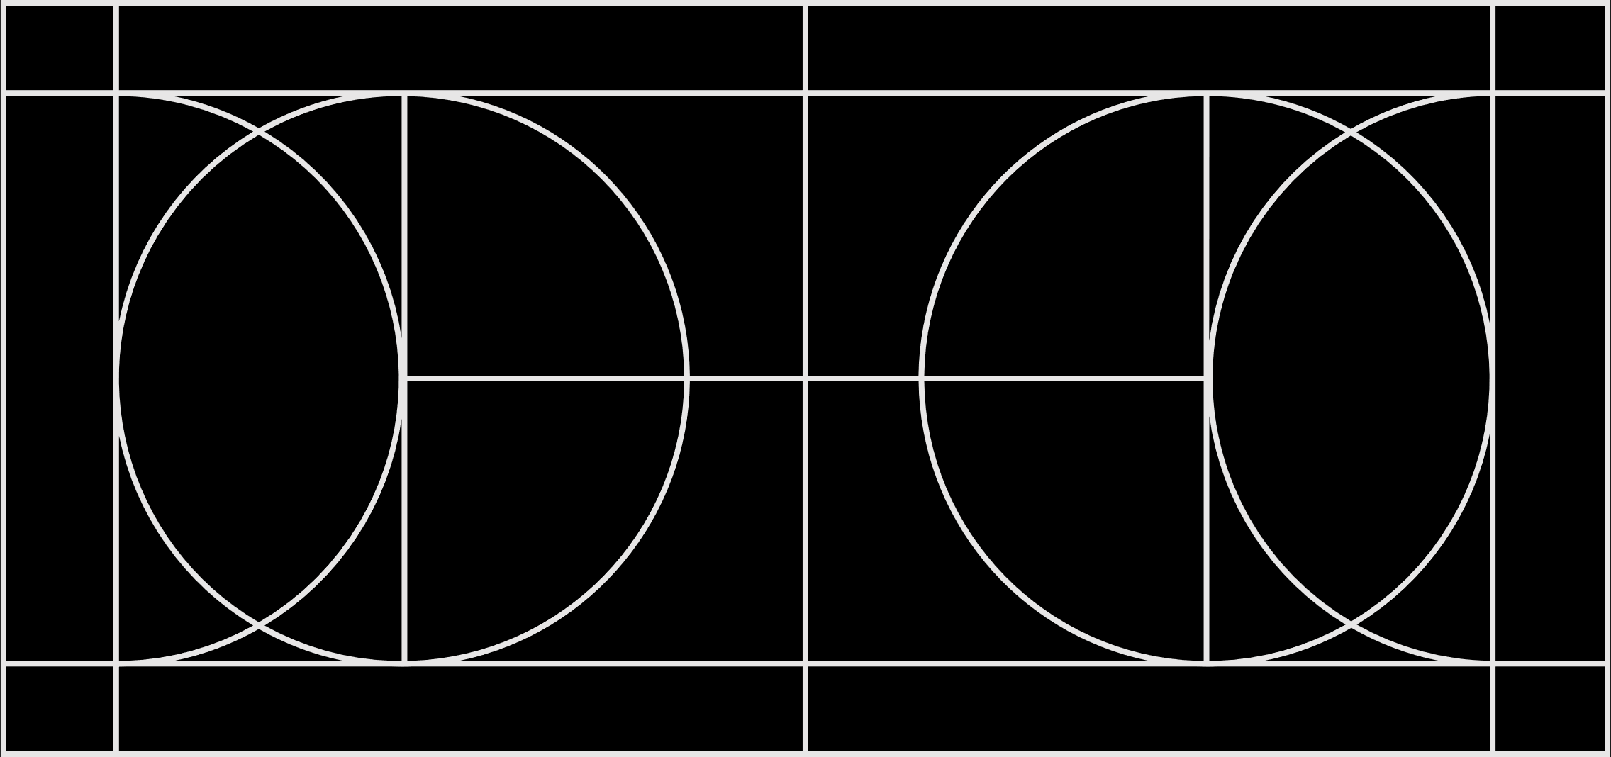
Probability of State change
State j
State i
k steps

Slide 24
Infinite State change

Slide 25
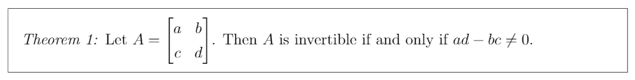
Invertible Matrix Test

Slide 26
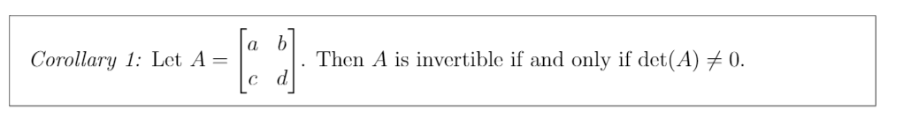
Determinant Invertibility Test

